Slide 1



Life Expectancy
View in Power BI
Last data refresh:
30/12/2022 18:15:43 UTC
Downloaded at:
30/12/2022 18:16:47 UTC

Slide 2
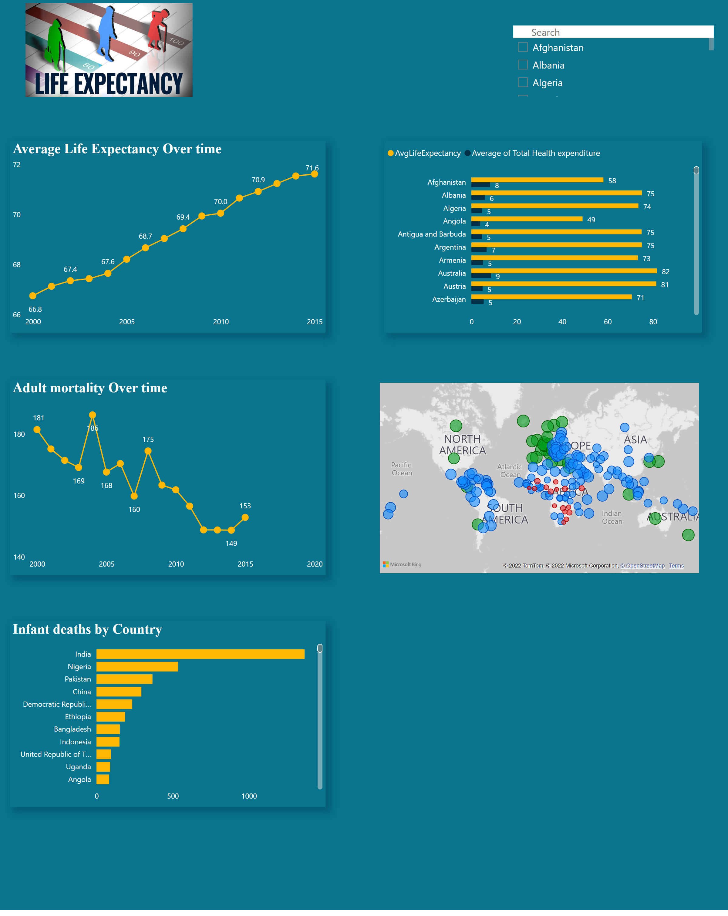
Page 1
Notes:
Average Life Expectancy Over time
No alt text provided
slicer
No alt text provided
map
No alt text provided
image
No alt text provided
clusteredBarChart
No alt text provided
Adult mortality Over time
No alt text provided
Infant deaths by Country
No alt text provided

